Slide 1
Cryptography Simulation with mbedTLS/Open SSL Library Usage and User Interaction
-By Team ByteForge

Slide 2
Problem Description
The project aims to address challenges in understanding and implementing cryptography by providing a practical simulation using mbedTLS or OpenSSL libraries. It focuses on bridging the gap between theoretical knowledge and practical application, promoting security awareness, and enabling hands-on learning of cryptographic principles and implementations.
In essence, the project addresses these challenges by providing a platform for users to learn and experiment with cryptography using established libraries, enhancing their understanding and ability to implement secure cryptographic solutions effectively.

Slide 3
Objective
The objective of this project is to simulate cryptographic operations using mbedTLS or OpenSSL libraries, enabling users to understand, implement, and interact with encryption, decryption, digital signatures, and hashing. It aims to promote hands-on learning of cryptographic principles, emphasizing security, customization, integration, and practical application in real-world scenarios.

Slide 4
Features Offered
Encryption and Decryption: Implement algorithms such as AES for symmetric encryption and RSA for asymmetric encryption, allowing users to encrypt and decrypt messages.
Digital Signatures: Enable creation and verification of digital signatures using algorithms like RSA or ECDSA, emphasizing data integrity and authenticity.
Hash Functions: Implement hash functions like SHA-256 for data integrity verification and password hashing, demonstrating secure hashing practices.

Slide 5
Key Management: Provide functionalities for generating, storing, and managing cryptographic keys securely, highlighting key size, storage, and distribution Considerations.
Error Handling and Validation: Implement robust error handling mechanisms and input validation to ensure secure and reliable cryptographic operations.
Performance Metrics: Measure and display performance metrics such as encryption/decryption speeds and memory usage to evaluate efficiency and scalability.

Slide 6
Process Flow
Setup: Ensure Docker Desktop is installed and is running. Create and run a Docker container, then select the operation.
Image Creation:
docker build -t crypto_app_image .
Running Container:
docker run -it crypto_app_image
SHA-256 Hashing:
Initialize SHA-256 context, compute hash, print result, and clean up context.

Slide 7
Process Flow
RSA Operations:
Encrypt: Process input, encrypt with RSA, and securely store keys.
Decrypt: Use stored private key for decryption.
Key Pair Generation: Create RSA public/private key pairs.
Digital Signatures: Sign and verify hashed messages for integrity.
AES and DES Operations:
Encrypt: Secure data with randomly generated key.
Decrypt: Access original data with correct key.
Cleanup:
Release resources for SHA-256, RSA, and AES operations to optimize memory and performance.

Slide 8
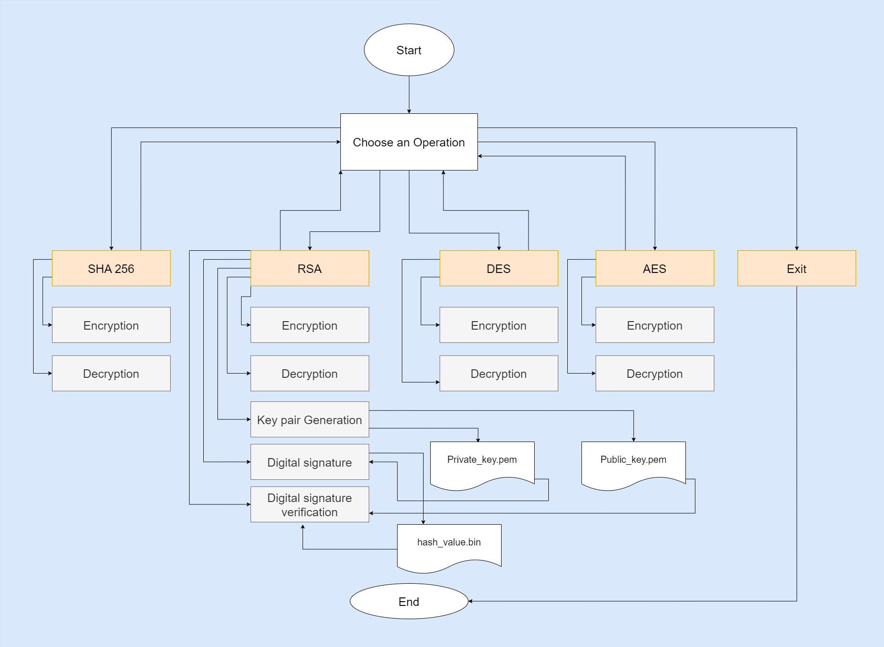
Architecture Diagram

Slide 9
Tools & Technologies Used
C Programming
GCC (GNU Compiler Collection)
Git
mbedTLS
Command Line
Docker

Slide 10
Team Members and Contribution
Samala Neelothpal -Backend, Management, containerization
Dasa Sathvika -RSA, Digital Signatures
Sri Priya Bhargavi -SHA,3DES algorithm
Mohammad Abdul Azeez -Documentation
Moturi Anudeep -AES algorithm

Slide 11
Conclusion
In conclusion, the cryptography simulation project holds significant promise in advancing understanding and proficiency in cryptographic principles. By offering practical engagement and educational content, it empowers users to navigate secure communication effectively. As a versatile resource for education, collaboration, and innovation, it aligns with industry standards and prioritizes continuous improvement through user feedback. Ultimately, it plays a crucial role in fostering a culture of security-consciousness and informed decision-making, contributing to a safer digital environment for all.

